Slide 1
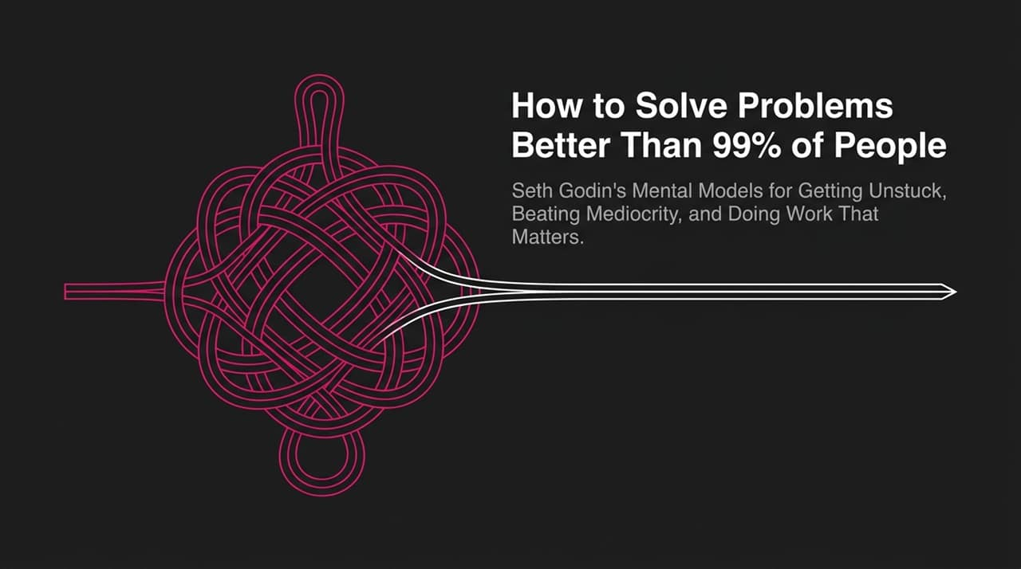
Notes:
Welcome, everyone. Today, we’re going to explore how to solve problems better than 99% of people by tapping into Seth Godin’s mental models for getting unstuck, beating mediocrity, and doing work that truly matters.
Most people spend their entire careers feeling stuck—whether in a job that doesn't fulfill them, with an audience that doesn't care, or stuck re-litigating decisions every single day. They feel like they're tangled in a complex knot they can't untie.
As Seth Godin outlines in his work and recent interviews, getting unstuck isn't about working 84-hour weeks, hustling until you burn out, or waiting for guaranteed success before taking a step. In fact, as Seth points out, true success and high performance are about clarity, intentionality, and recognizing the invisible forces—or entanglements—that govern our choices.
Look closely at the cover image on this slide: a tight, tangled knot surrounding a solid central post. Many people think solving big problems requires slashing through the complexity with a brute-force sword. But historical legend and smart problem-solvers know better: if you simply pull out the central post, the entire knot unravels.
Over the next 11 slides, we are going to unpack the mental frameworks, daily practices, and leadership choices that will allow you to pull out that central post in your own life and career. Let's dive into why most people get trapped in average work in the first place.
https://www.youtube.com/watch?v=o8yD6nt71Cs

Slide 2
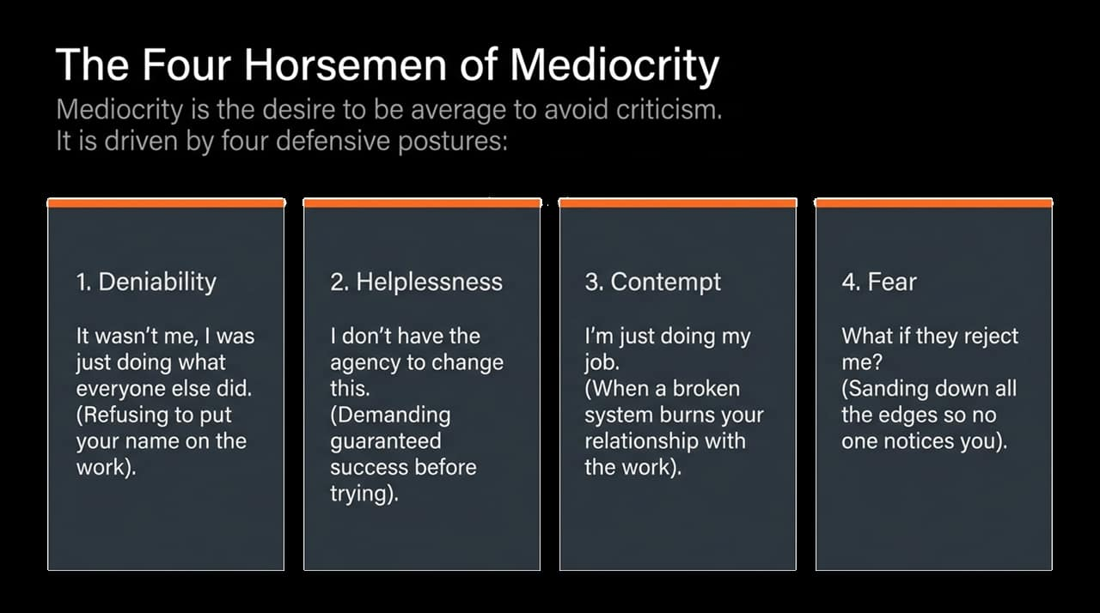
Notes:
Before we talk about excellence, we have to talk about mediocrity. What does 'mediocre' actually mean? At its root, it simply means 'average.' Mediocrity isn't a lack of talent—it is a choice. It is the desire to be average specifically so you can avoid criticism.
When we are afraid of standing out or getting hurt, we adopt four defensive postures—what Seth calls the 'Four Horsemen of Mediocrity':
Deniability: This sounds like: 'It wasn't me, I was just doing what everyone else was doing.' It’s the refusal to put your name on your work. If things go wrong, you can deny responsibility because you followed the crowd.
Helplessness: This is the mindset of: 'I don't have the agency to change this.' People in this posture demand a guarantee of success before they're willing to try. They say, 'If you guarantee everyone will love my idea and nothing bad will happen, I’ll do it.' But because those guarantees don't exist in the real world, they stay put.
Contempt: This is expressed as: 'I'm just doing my job.' When a broken industrial system burns an employee's relationship with the work, they stop caring about the customer or the outcome. It’s a protective mechanism to avoid caring.
Fear: Ultimately, the underlying driver is fear: 'What if they reject me?' To cope, people sand down all the rough, interesting edges of their work until it is so banal and safe that no one notices them.
Ask yourself right now: Which of these four postures do you retreat to when things get tough? To escape mediocrity, we must identify these defense mechanisms and reject the illusion of safety they promise.

Slide 3
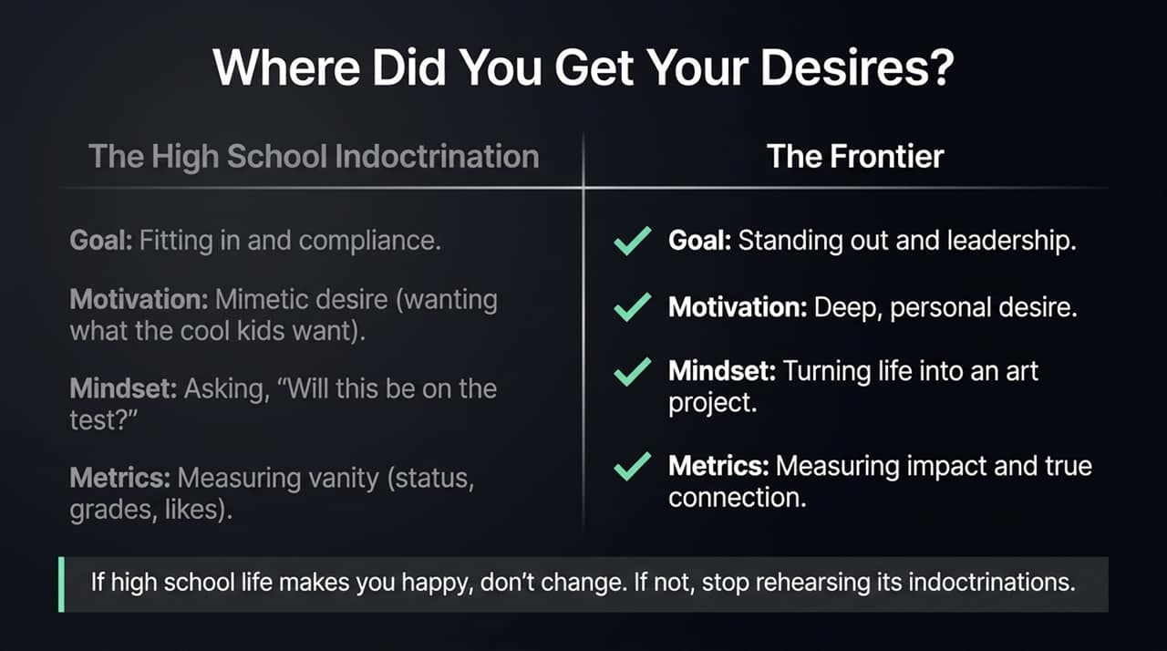
Notes:
To understand why we default to these defensive postures, we have to ask a fundamental question: Where did you get your desires?
Seth Godin frequently notes that when adults feel lost or stuck, the answer almost always traces back to two words: High School.
Our modern schooling system was originally designed during the Industrial Age by factory owners to condition people for factory work. The primary goal was compliance, fitting in, and standing on the assembly line without causing trouble. In high school, motivation is driven by mimetic desire—wanting things simply because the 'cool kids' want them. The core mindset becomes asking, 'Will this be on the test?' and measuring vanity metrics like status, grades, or likes.
But if you want to do work that matters, you have to transition from the High School Indoctrination to The Frontier:
On the Frontier, the goal isn't fitting in; it’s standing out and leading.
Your motivation shifts from mimetic desire to deep, personal desire.
Your mindset turns life into an art project—creating generous, meaningful work.
And your metrics change from vanity metrics to measuring real impact and true connection.
Seth leaves us with a powerful reality check: If high school life makes you happy as an adult, don't change a thing. But if it doesn't, stop rehearsing its indoctrinations. It’s time to stop asking if it’s going to be on the test and start creating your own art.

Slide 4
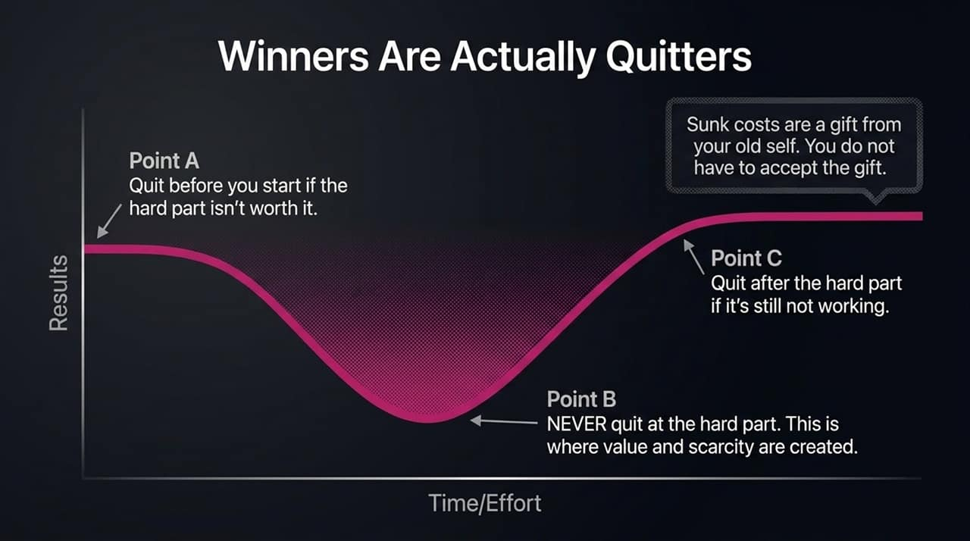
Notes:
We've all heard the old Vince Lombardi quote: 'Winners never quit, and quitters never win.' Seth Godin argues that this is complete nonsense. Winners are actually quitters—provided it is strategic quitting.
Quitting isn't failing. Failing is sticking with something that isn't working and isn't making you happy just because you started it. Quitting is simply freeing up your resources to invest in the thing you should be doing next.
Look at the curve on this slide to understand how strategic quitting works:
Point A (Before you start): Realize before you embark on a project that there will be a hard part. If the ultimate reward isn't worth going through that hard part, quit before you start.
Point B (The Dip / The Hard Part): NEVER quit at the hard part. The hard part is precisely where value, scarcity, and competitive advantage are created. If it were easy, everyone would do it.
Point C (After the Dip): If you've pushed through the hard part and the project still isn't delivering results or bringing value, quit after the hard part.
The key mental hurdle here is handling Sunk Costs. Seth offers a beautiful perspective on this: Sunk costs are a gift from your old self. You do not have to accept the gift. Just because you spent years in a career or invested thousands of dollars in a path doesn't mean your present self owes it to your past self to keep suffering.

Slide 5
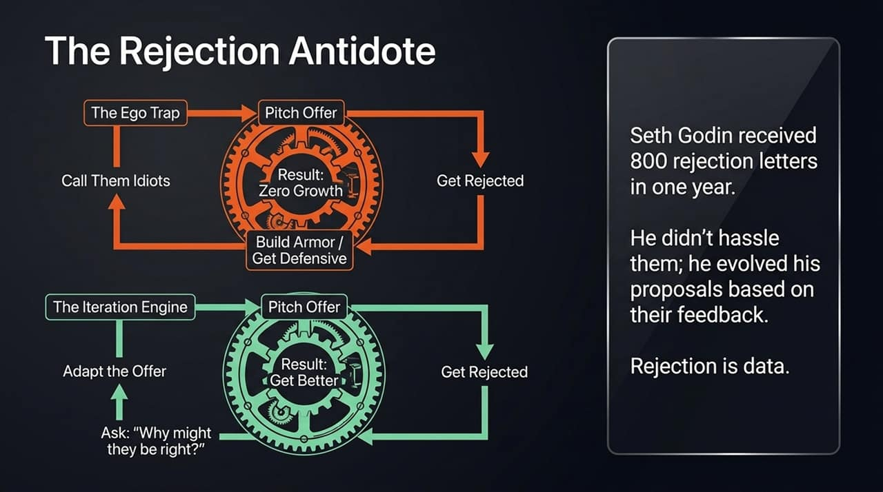
Notes:
When you put yourself out there and try something new, you will face rejection. How you respond to that rejection determines whether you stay stuck or grow.
Most people fall into The Ego Trap (shown in red): They pitch an offer, get rejected, and immediately feel a bruised ego. To protect themselves, they build armor and get defensive. They think, 'They didn't buy my offer because they're idiots.' This protective loop leads to zero learning, zero adaptation, and zero growth.
Contrast that with The Iteration Engine (shown in green): In Seth Godin's early career as a book packager, he received 800 rejection letters in a single year! Think about that—800 times someone wrote back and said 'No.' But Seth didn't spam people, hustle them, or call them idiots.
Instead, he used rejection as data. Every time he was rejected, his proposals got slightly better because he asked a crucial question: 'Why might they be right?'
Everyone who makes a decision is correct based on who they are, what they believe, and what they heard from you. If you want a different answer, you can't blame them; you must adapt your offer and tell a better story. Rejection isn't personal—it's feedback.

Slide 6
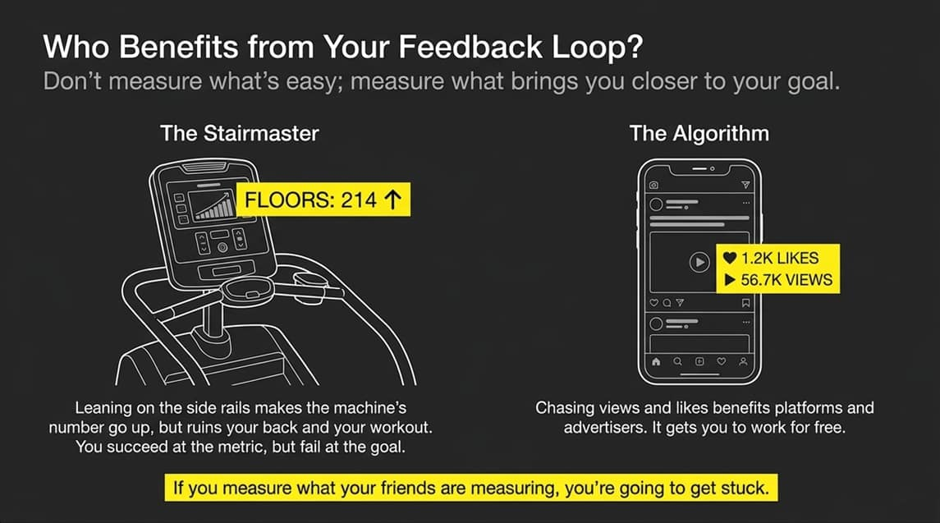
Notes:
To iterate effectively, you need feedback loops. But you must ask yourself a critical question: Who benefits from the feedback loop you are using?
Take a look at the two examples on the slide:
The Stairmaster Analogy: Have you ever seen someone at the gym leaning heavily on the side rails of a Stairmaster? Why do they do that? Leaning takes the weight off their legs, ruins their posture, and reduces the quality of their workout. But they do it because it makes the floor counter on the screen go up faster! They succeeded at the metric, but failed completely at the goal.
The Algorithm Trap: The exact same thing happens on social media. Platforms like Instagram or YouTube make views and likes easy to track because they benefit when you chase those numbers. If you get addicted to vanity metrics, you end up doing outrage-bait or cheap tricks to make the numbers go up, essentially working for the platform for free.
Don't measure what is easy to measure; measure what actually brings you closer to your goal. If you spend your time measuring what everyone else is measuring, you're going to get stuck in the exact same place they are.

Slide 7
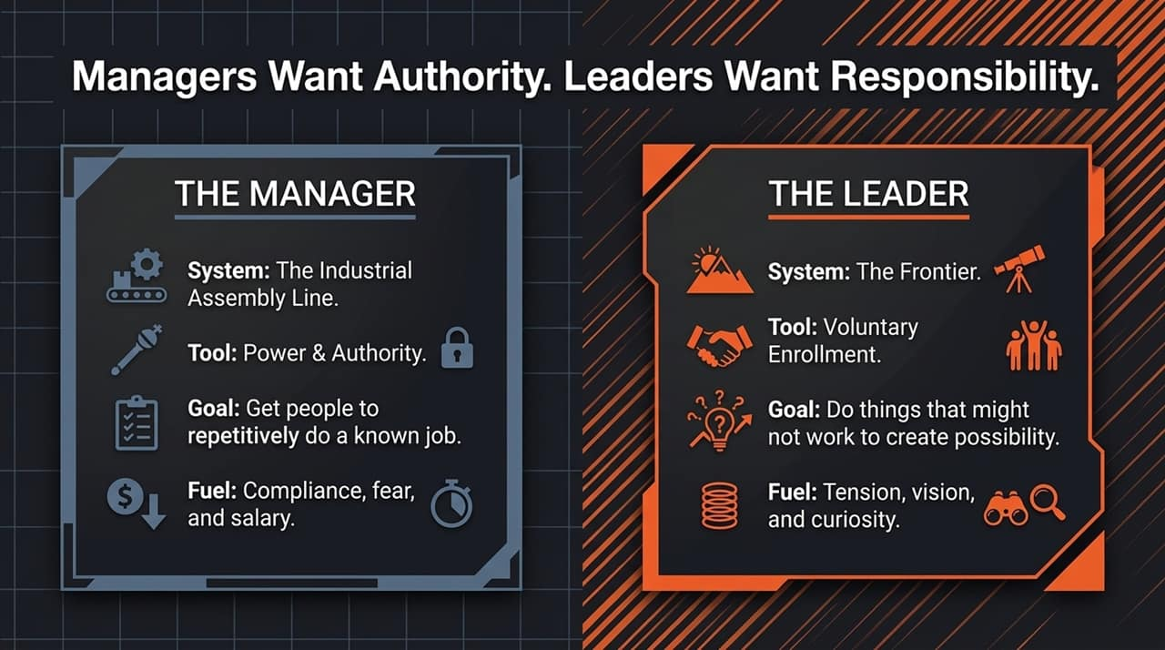
Notes:
One of the fundamental shifts in getting unstuck is moving from a manager mindset to a leader mindset. Many organizations are full of managers, but starved for leaders.
Let's look at how Seth Godin distinguishes the two:
The Manager belongs to the Industrial Assembly Line.
Their primary tool is Power & Authority.
Their goal is to get people to repetitively do a job that is already known and understood.
Their fuel is compliance, fear, and salary. They operate under the rule: 'Do what I say or you'll be punished.'
The Leader, on the other hand, operates on The Frontier.
Their primary tool is Voluntary Enrollment. You cannot force someone to follow a leader; they must choose to.
Their goal is to do things that might not work in order to create new possibilities.
Their fuel is vision, tension, and curiosity.
As the slide states: Managers want authority, but leaders want responsibility. Leadership means stepping up to say, 'I'm going over here—who wants to come with me?' It requires taking responsibility for outcomes on the frontier of uncertainty.

Slide 8
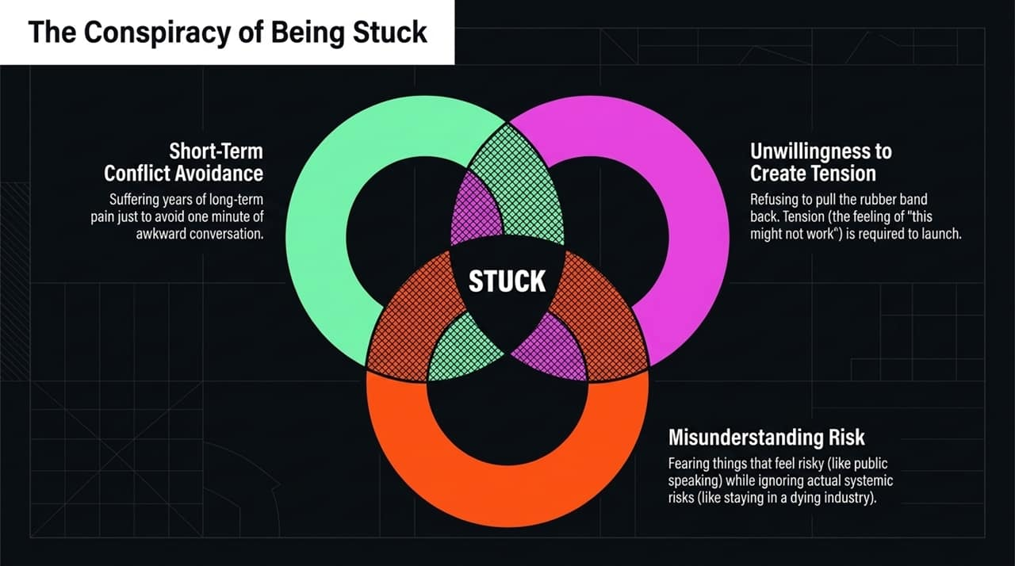
Notes:
Why do so many smart, capable people end up stuck? Seth Godin calls this 'The Conspiracy of Being Stuck,' created by the overlap of three major confusions:
Short-Term Conflict Avoidance: Human beings naturally dislike uncomfortable conversations. But far too often, people suffer through years of long-term organizational or career pain just to avoid one minute of awkward conversation. They choose chronic discomfort over acute short-term clarity.
Unwillingness to Create Tension: People confuse stress with tension. Stress is bad—it wears down your body and mind. Tension, however, is like pulling back a rubber band before releasing it. Without pulling the band back, it won't fly. Leadership and change require inflicting intentional tension—that feeling of 'this might not work'—to move forward.
Misunderstanding Risk: We are notoriously bad at evaluating risk. We fear things that feel risky (like public speaking, asking for a raise, or pitching a new idea) even though they carry zero physical or systemic risk. Meanwhile, we ignore actual, massive systemic risks—like staying passive in a dying industry or doing work that AI can easily automate.
When you avoid conflict, refuse to create tension, and miscalculate risk, you lock yourself right in the center of being STUCK.

Slide 9
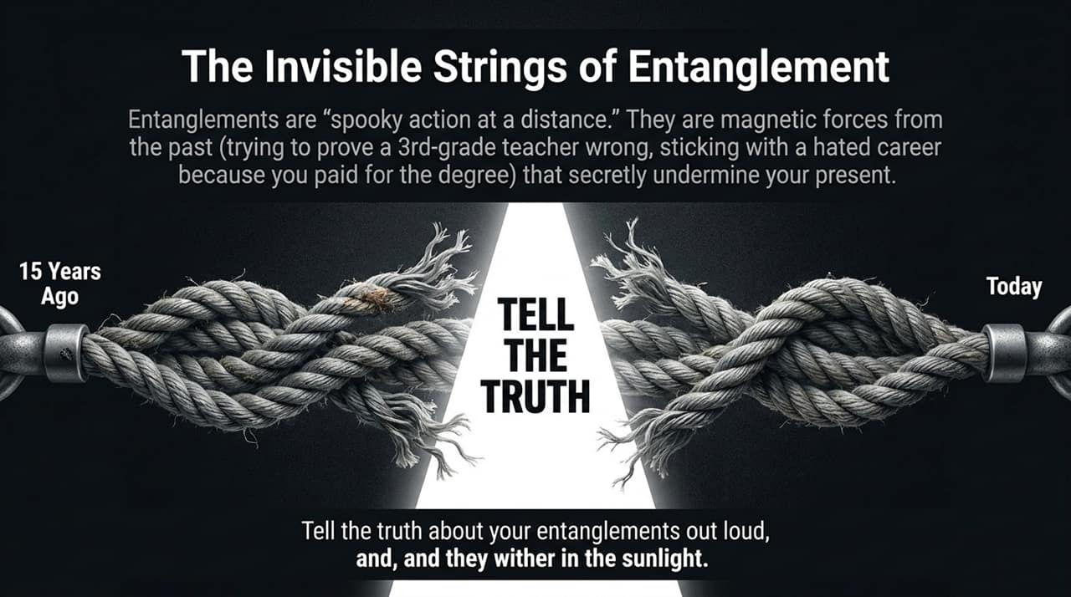
Notes:
At the core of why we stay stuck are what Seth calls Entanglements. Borrowing a term from physics, entanglements are 'spooky action at a distance.'
They are invisible, magnetic forces from your past that secretly dictate your decisions today:
It's the entrepreneur still trying to prove a 3rd-grade teacher wrong.
It's the professional spending 30 years in a career they despise simply because they paid $300,000 for the degree 15 years ago.
It's holding onto a broken process at work because 'that's how we've always done it.'
Entanglements stay alive because they excel at preserving themselves in the dark. They hide behind excuses and comfort.
So, how do you break free? The antidote is remarkably simple, yet requires immense courage: TELL THE TRUTH.
Tell the truth about your entanglements out loud. When you speak your entanglements out loud—'I am only staying in this job because I'm afraid my parents will be disappointed'—the absurdity becomes clear, and the force of the entanglement withers in the sunlight.

Slide 10
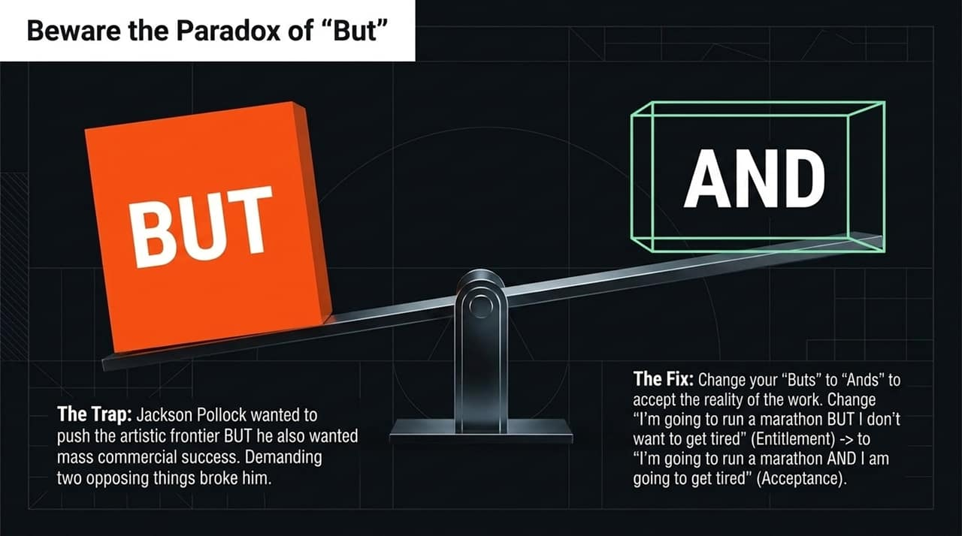
Notes:
When we set out to do meaningful work, we often trip over a single word: 'BUT.'
Seth shares a compelling story about Jackson Pollock, one of the most famous painters of the 20th century. Pollock achieved immense success with his iconic drip paintings. But he wanted to push the artistic frontier further. He went back to his studio and created a completely new, radically different line of work.
When he launched it, the critics hated it and nobody bought it. Pollock broke under the pressure because he demanded two opposing things at once: He wanted to be on the radical frontier BUT he also wanted mass commercial applause and instant riches. Expecting both caused him to break.
The Trap: Saying 'BUT' creates entitlement. 'I want to run a marathon BUT I don't want to get tired.'
The Fix: Replace your 'BUTs' with 'ANDs' to accept reality:
Change 'I want to run a marathon BUT I don't want to get tired' to 'I am going to run a marathon AND I am going to get tired.'
Change 'I want to build an innovative product BUT people might reject it' to 'I am going to build an innovative product AND it might not work.'
Embracing 'AND' shifts your posture from entitlement to acceptance.

Slide 11
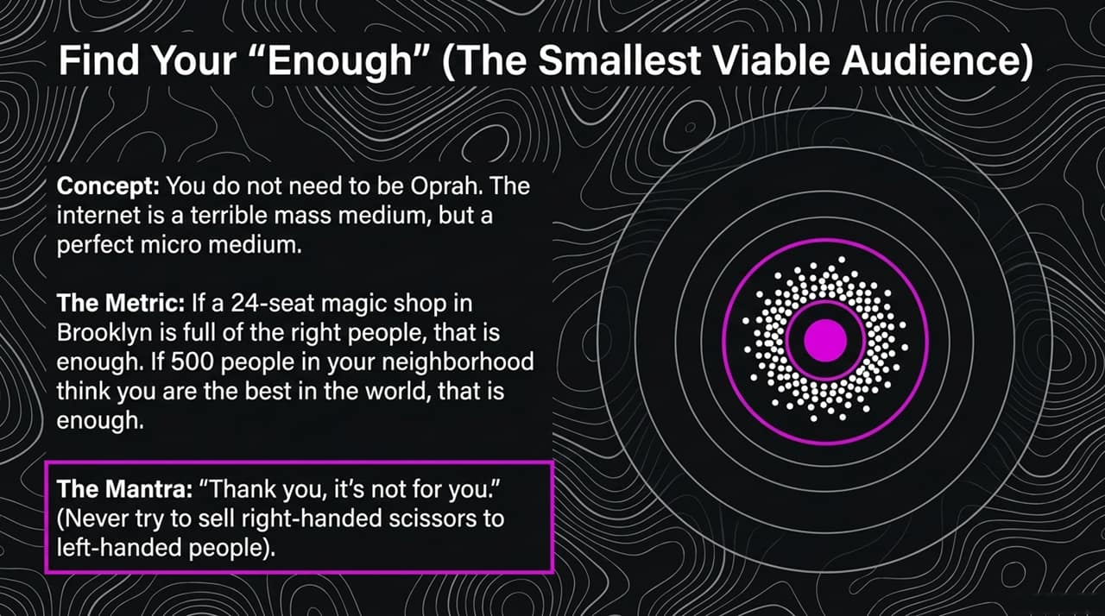
Notes:
In an era where everyone is trying to go viral, one of the most liberating frameworks Seth Godin teaches is finding your Smallest Viable Audience.
You do not need to be Oprah. You do not need millions of followers to build a thriving business or career. The internet is actually a terrible mass medium, but it is a perfect micro-medium. It is designed to connect niche groups of people who care about specific things.
The Metric: Define what 'Enough' looks like. Seth shares the story of a secret 24-seat magic theater behind a bookshelf in Brooklyn. If those 24 seats are filled with the right people who are deeply moved by the performance, that is enough. If you are a local business and 500 households in your neighborhood think you are the best in the world at what you do, that is enough.
The Mantra: To serve a specific audience well, you must adopt the mantra: 'Thank you, it's not for you.'
If you make scissors specifically for right-handed people, you don't spend your energy arguing with left-handed people or trying to convert them. You simply say, 'Thank you, it's not for you,' and focus entirely on serving the people who care.

Slide 12
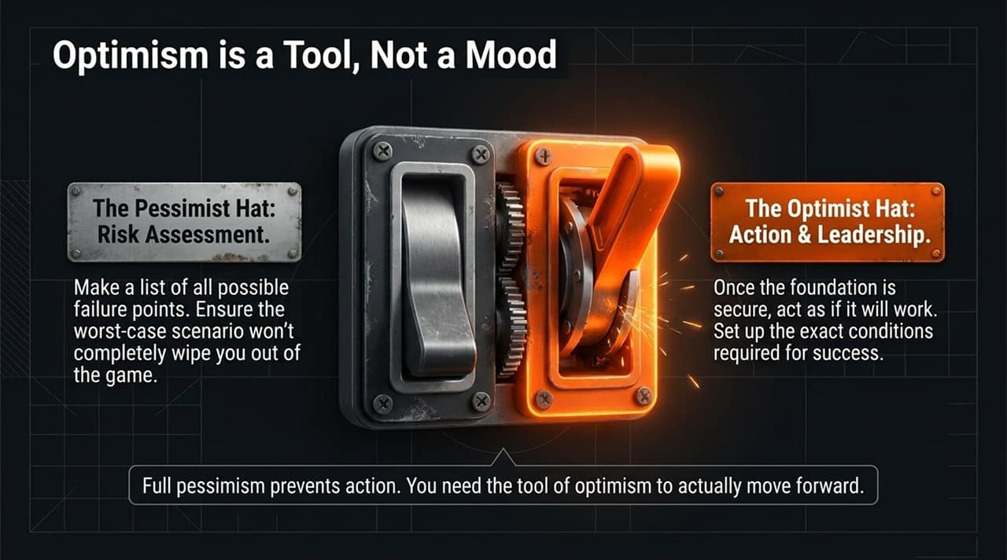
Notes:
When we look at why so many talented professionals find themselves stuck, we often blame a lack of resources, time, or motivation. But as Seth Godin highlights in The Knot, 'stuck' is often just a code word for 'comfortable'. We construct psychological habits and confusions that keep us safe in the middle—avoiding the friction required to break through.
Godin identifies three core confusions that drive this conspiracy of being stuck:
First, Short-Term Conflict Avoidance. For thousands of years, humans survived by maintaining social harmony. But today, that instinct backfires. People will suffer through years of systemic pain, toxic work environments, or misaligned roles just to avoid one minute of awkward conversation at work or home. We have to realize that enduring short-term awkwardness is a prerequisite for long-term clarity and freedom.
Second, an Unwillingness to Create Tension. People confuse tension with stress. Stress is damaging; tension is potential energy. Think of pulling a rubber band back—if you don't pull it back, it won't fly across the room. When you launch a new product, lead a transformation, or ask for enrollment, you must inflict intentional tension. It’s the feeling of 'this might not work,' and without it, nothing changes.
Finally, Misunderstanding Risk. Humans are notoriously terrible at evaluating risk rationally. We buy insurance before getting on airplanes, even though the drive to the airport is drastically more dangerous. In business, public speaking or making a bold pitch feels high-risk, but no one ever dies from a rejected proposal. The real, systemic risk is staying quiet in an industry that is rapidly being mechanized.
To move forward, we have to look closely at these hidden forces—or what Seth calls our 'entanglements'.
Transition to Slide 13: "Now, let's look at where these entanglements come from and how we can untangle them.

Slide 13
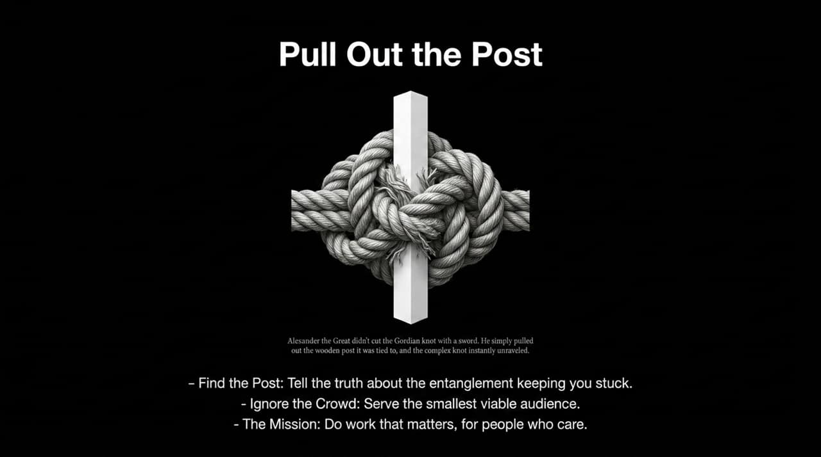
Notes:
Seth uses the quantum physics term 'spooky action at a distance' to describe entanglements. These are invisible magnetic pull points from our past—a grade school teacher who doubted us, a degree we paid $300,000 for 15 years ago, or a sunk cost we refuse to forgive. We stay stuck in careers or patterns because we feel obligated to choices made by a past version of ourselves.
How do you break an entanglement? You tell the truth out loud. When you expose entanglements to sunlight by stating them clearly—'I'm continuing this meeting structure only because I want approval,' or 'I'm staying in this role because of a choice I made 10 years ago'—the absurdity becomes clear, and the grip loosens.
This brings us to the Paradox of "But". Look at the painter Jackson Pollock in the mid-1950s. He was the most famous artist in America, selling out every drip painting. But he wanted to push the artistic frontier AND he demanded commercial, sold-out success for his radical new style. Demanding both simultaneously broke him.
We do this every day when we say things like: 'I want to run a marathon, BUT I don't want to get tired'. That is entitlement. To fix it, swap your 'BUT' for an 'AND': 'I am going to run a marathon, AND I am going to get tired'. Acceptance clears the path for reality.
Once you accept the work, you must define your Smallest Viable Audience. You don't need mass appeal or millions of superficial followers. The internet is a terrible mass medium, but a phenomenal micro medium. Seth references a hidden 24-seat magic shop room in Brooklyn. If that room is filled with the right 24 people, it’s a masterclass. When someone rejects your offering, adopt the ultimate creator mantra: 'Thank you, it's not for you.'
Transition to Slide 14: "To turn this clarity into actual movement, we need to talk about mindset and how we frame optimism.

Slide 14
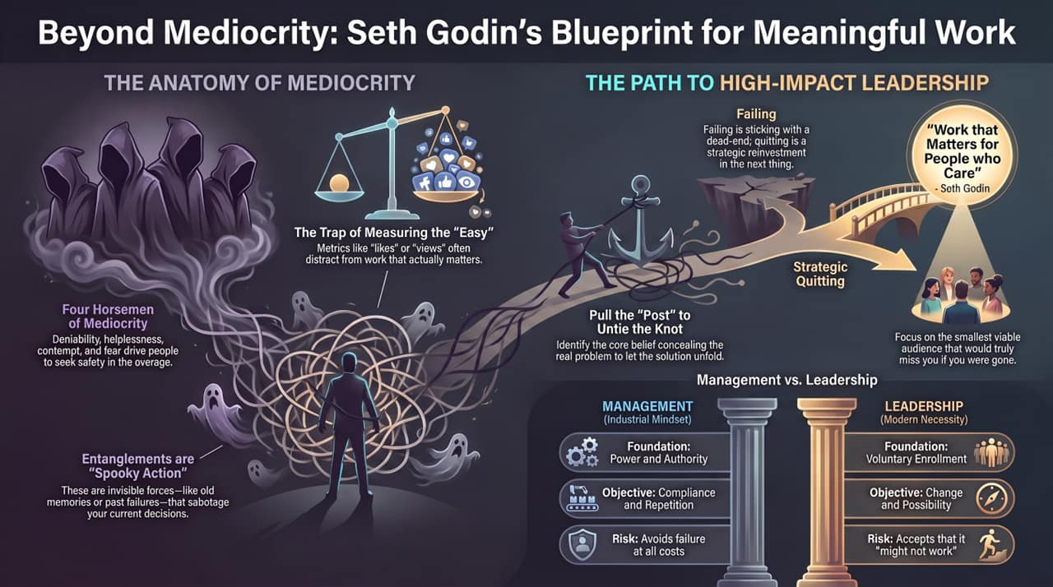
Notes:
Many analytical thinkers pride themselves on being 'realists' or cynics, believing pessimism keeps them safe. But chronic pessimism leads directly back to helplessness and deniability—it guarantees mediocrity. Seth Godin reframes this: Optimism is not a mood or a feelings-based disposition; it is a strategic tool.
Effective execution requires knowing when to wear two distinct hats:
First, put on your Pessimist Hat during the risk assessment phase. Ask: What are the specific points of failure? What happens if this launch tanks? The goal here is simple: ensure the worst-case scenario doesn't wipe you out or remove you from the game entirely. You protect your downside.
But once that foundation is secure, take off the pessimist hat and put on The Optimist Hat. Leadership and execution demand that you act as if it will work. You must build the infrastructure, enroll the team, and create the exact conditions required for success.
If you stay in perpetual pessimism, you talk yourself out of taking action. You need the deliberate tool of optimism to step onto the frontier.
Transition to Slide 15: "This brings us to our ultimate conclusion: how to untie the knot entirely and move forward.

Slide 15
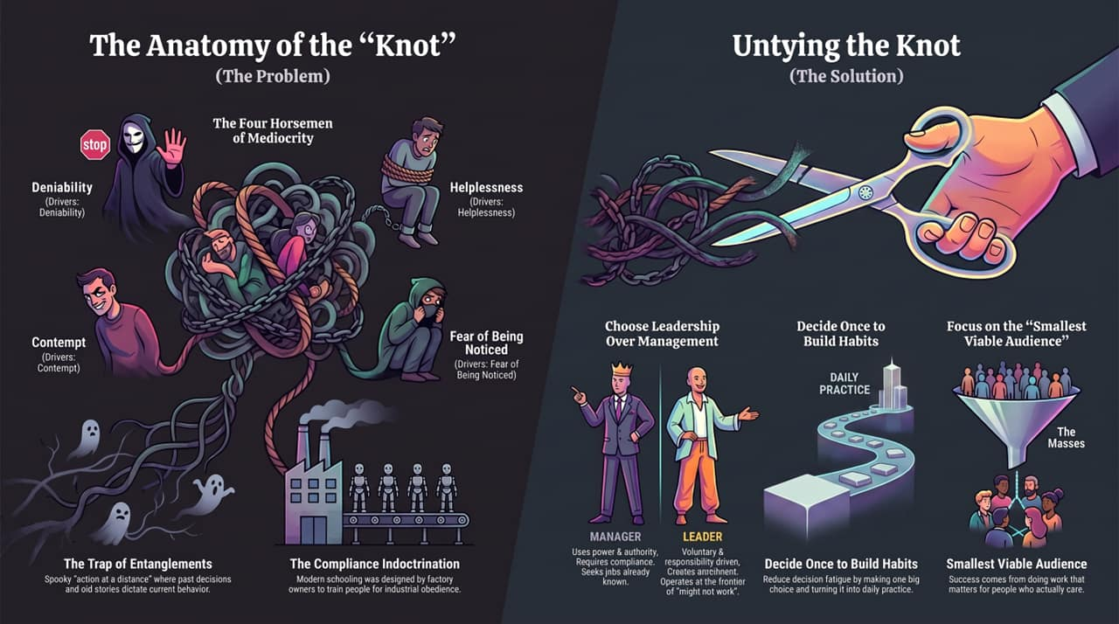
Notes:
Legend tells us that when Alexander the Great encountered the famous Gordian Knot in Turkey, he drew his sword and sliced it in half. But as Seth notes, that's not what actually happened.
Alexander walked up to the ox cart, looked past the tangled mess of ropes, and noticed a central wooden pin holding the assembly to the frame. He pulled out the post, and the complex knot unraveled on its own.
Most people spend years picking frantically at the outer loops of their problems—trying new productivity hacks, chasing vanity metrics, or pleasing external critics. They are picking at the knot while leaving the post firmly in place.
To untie your knot and solve problems better than 99% of people, you must follow three steps:
Find the Post: Tell the absolute truth about the underlying entanglement or fear that is keeping you comfortable. Pull it out.
Ignore the Mass Audience: Stop trying to appeal to everyone or chasing viral reach. Serve your Smallest Viable Audience—the specific group of people who would genuinely miss your work if you were gone.
Embrace the Core Mantra: Center your daily practice on doing 'work that matters, for people who care.'
Problems are solvable when we stop confusing them with unchangeable situations. When you make a single decision to lead, build daily habits around your craft, and pull out the post, you step off the factory floor and onto the frontier.

